Slide 1
Week 5 Workshop
React Course

Slide 2
Agenda
Activity​ | Time​
Get Prepared: Log in to Nucamp Learning Portal • Slack • Screenshare | 10 minutes​
Check-In​ | 10 minutes​
Weekly Recap: Redux Actions & Thunk, Json-server, Fetch, Animations | 50 minutes​
Task 1: ​ | 50 minutes​
BREAK​ | 15 minutes​
Tasks 2 & 3​ | 90 minutes​
Check-Out​ | 15 minutes​

Slide 3
Check-In
How was this week? Any particular challenges or accomplishments?
Did you understand the Exercises and were you able to complete them?
You must complete all Exercises before beginning the Workshop Assignment. We will review the Exercises together next, along with this week's concepts.

Slide 4
Week 5 Recap – Overview
Some of the New Concepts You Learned This Week
Next slides will review these concepts, along with some of the Exercises you did this week.
Combining Reducers Redux Actions Redux Thunk Middleware | Json-server REST & HTTP Methods Fetch & Promises Animations

Slide 5
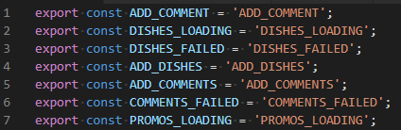
Redux Action Types – Why?
We have been keeping action types in a separate file as constants, e.g.:
Discuss as a class: Why have we been doing this? It could seem like we're just repeating ourselves.

Slide 6
Redux Action Types – Why?
Some answers, straight from the Redux documentation:
It helps keep the naming consistent because all action types are gathered in a single place.
Sometimes you want to see all existing actions before working on a new feature. It may be that the action you need was already added by somebody on the team, but you didn't know.
The list of action types that were added, removed, and changed in a Pull Request helps everyone on the team keep track of scope and implementation of new features.
If you make a typo when importing an action constant, you will get undefined. Redux will immediately throw when dispatching such an action, and you'll find the mistake sooner.
Note: Like Redux itself, this may be more useful in larger projects. In very small projects with few actions, this may not be necessary, and Redux will not force you to do it. However, for the reasons noted above, it is a good idea and a very common convention.

Slide 7
Redux Action Types - Importing
You have seen this syntax for importing action types for use in another file:
import * as ActionTypes from './ActionTypes';
What is import * as ____ doing? It makes all your exported constants available to you in that file as ____.<name of const>. E.g.
ActionTypes.DISHES_LOADING
If you had written instead:
import * as Foo from './ActionTypes';
Then you would have to use: Foo.DISHES_LOADING
(but don't use Foo.)

Slide 8
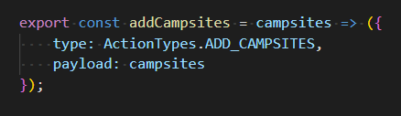
Redux Action Creators
Action: a JavaScript object with an action type and often a payload of data sent to the Redux Store.
Action creator: a function that creates and returns an action, e.g.:
Remember, an arrow function that has only one expression in its function body, without curly braces surrounding the function body, will return that expression automatically even though there is no return statement.
When you want to dispatch this type of action, you call the action creator function inside dispatch, e.g. dispatch(addCampsites(campsites))
Using action creators is a convention as well. Redux does not force you to do this. You could instead create your action object inside your dispatch, such as: dispatch({ type: ActionTypes.ADD_CAMPSITES, payload: campsites})
Using an action creator ensures that if you need to change how your action is created, for example if you need to introduce some Redux Thunk middleware, then you only need to change it in one place instead of chasing it down all over your code.

Slide 9
Redux Reducers
Actions describe what happened (or what you want to happen), such as ADD_COMMENT and a payload that holds the comment you want to add.
Reducers do the work of actually making things happen.
Using dispatch() sends the action to the store, where it is handled by the root reducer defined in createStore()
Reducers are pure functions with this signature:
(previousState, action) => newState
They take the dispatched pre-existing state and an action, then create and return the new state (without mutating the old state) to the store.

Slide 10
And then what?
You may have heard React being called "declarative".
This means that in React, you do not tell the DOM exactly what to do - delete this node, add that node, etc.
Instead, you set the virtual DOM the way you want it – you declare what you want, and the real DOM reacts without you touching it directly, thanks to React magic (a process called reconciliation).
With Redux added to React, this declaration happens via the action and reducer pattern ultimately modifying the application state inside the Redux Store.
The Store then saves this new state as the new virtual DOM state, and via the React-Redux bindings, your React app will update as necessary.

Slide 11
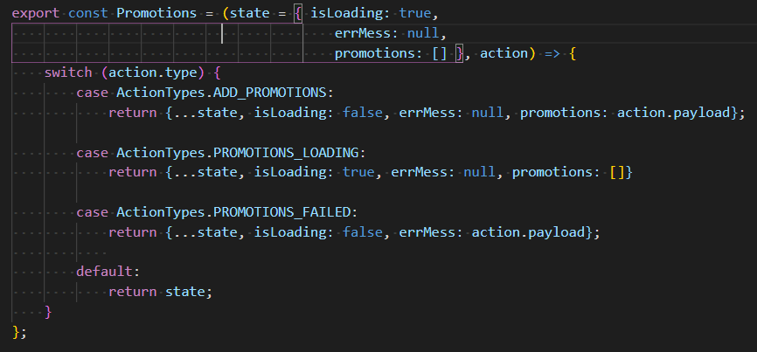
Redux Reducers
(currentState, action) => newState
The reducer function takes two arguments: the current state and the action that has been dispatched.
Most often, it will use a switch statement to cycle through potential action types, create a new state object with the change requested by the action, then return it.
Discuss in class: What does the state = syntax do in the parameter list of this reducer?

Slide 12
Redux Middleware
Redux Middleware lets you insert code that's executed after an action is dispatched and before it reaches the reducer, via using applyMiddleware() in your call to createStore().
applyMiddleware(...middleware) - you can chain middleware functions as arguments to applyMiddleware here so that actions can go through multiple middleware in turn (such as thunk and logger)
This is the preferred method for a third-party extension point, where you can intercept and view/modify/stop the action before it reaches the reducer, or dispatch other actions

Slide 13
Redux Thunk
Thunk is a general programming concept where you place a function inside another function to be executed later.
Redux Thunk is a type of middleware that allows you to write action creators that return a function instead of an object.
A common example: If you want to send a call to a server then wait for it to respond before dispatching another action, Thunk helps you do that.

Slide 14
Client-Server Communication
HTTP – hypertext transmission protocol
Get, Put, Post, Delete HTTP methods (there are others – Head, Options..)
HTTP response status codes e.g. 200, 404, 303 ...
URL – uniform resource locator, unique address of files on servers that are on the internet
JSON – JavaScript Object Notation
Strings containing information in similar format as a JavaScript object literal with a few differences, mainly that the property name must be in double quotes: { "id": 1, "wings": 2 }
one way of encoding data transmitted between server & client that is extremely easy to plug into JavaScript and to extract data from as objects
There are other ways to encode data for transmission, e.g. XML

Slide 15
The Cloud
Modern web apps often hosted on 'cloud' backend
The 'cloud' is a cluster of server computers, if one fails your server is moved to another, high-traffic and crucial websites are safer using cloud services
Developers/companies used to (and some still do) host their own websites on their own servers they would manage, or they would use web shared hosting providers.
Now there are many cloud services that manage servers for you – Amazon Web Services, Azure, Heroku, Digital Ocean, etc.

Slide 16
REST: Representational State Transfer
Architectural style for developing Web services (resources available on the Web)
REST is not a library, not a framework, not a language, just a standardized approach to handling network data transfer
Two common approaches: REST and SOAP (REST is newer)
SOAP: Simple Object Access Protocol, uses XML for data encoding instead of JSON, other differences – is an actual protocol specification unlike REST
REST: Can use either XML or JSON (or even plain text or HTML), most often JSON
REST becoming increasingly popular

Slide 17
REST (cont)
6 principles of RESTful web service/API
Client/server separation
Statelessness
Uniform Interface
Cacheable
Layered System
Code on Demand (optional)

Slide 18
REST (cont)
REST uses HTTP methods Get, Post, Put, Delete, roughly analogous to Read Create Update Delete in CRUD terms
CRUD operations: Create Read Update Delete
CRUD operations are a general computer/database programming paradigm of the four basic operations you can do with data.
Resource and Representation -
Any piece of data available from the server is a "resource"
When a resource is requested, the server will encode it into the appropriate format for transfer, such as JSON, and this is the "representation" that is sent over the network.
The resource is not sent, the representation is what's transferred.

Slide 19
Promises
A part of ES6 JavaScript
Allows us to run code asynchronously – not all on the same timeline
We can send out requests but not have to wait for the responses to continue executing our app, deal with responses later when they return
Creating a promise: new Promise( function(resolve, reject) { ... } );
Example: const myFirstPromise = new Promise((resolve, reject) => { … });
The function being passed into the Promise constructor is called the executor function. It takes two other functions (resolve, reject) as arguments.
resolve: called when promise task succeeds, return value holds task results
reject: called when task fails, returns reason for failure – typically an error object.

Slide 20
Promises
The .then() method is used on a promise to handle what happens when a promise resolves or rejects
The first argument of the .then() method is a callback function that handles the resolve case, the second (optional) argument handles the reject case
The return value of a .then() method is returned as another promise, so you can chain them together to create a promise chain
The .catch() method can be chained to a .then() method to catch any rejected promises that are not handled
The throw statement can be used at any point to throw to the next available catch block

Slide 21
Fetch
Modern API replacement for XMLHttpRequest
Alternatives: Axios, Superagent
Supports promise-based approach – fetch() returns a promise
Client makes fetch requests, server makes fetch response.
Fetch requests must provide a URL, may also provide a request method (default is GET), headers, body, more
Fetch responses will provide a status code (404, 200, etc) and a response.ok property (true for 200-299 status code), may also include headers, body, more

Slide 22
Workshop Assignment
It's time to start the workshop assignment!
Sit near your workshop partner.
Your instructor may assign partners, or have you choose.
Work closely with each other.
10-minute rule does not apply to talking to your partner, you should consult each other throughout.
Follow the workshop instructions very closely
both the video and written instructions.
Talk to your instructor if any of the instructions are unclear to you.

Slide 23
Check-Out
Turn in your assignment files:
AboutComponent.js, ActionCreators.js, ActionTypes.js, ContactComponent.js, HomeComponent.js, partners.js, MainComponent.js
Wrap up – Retrospective
What went well
What to improve
Action items suggestions
Work on your Portfolio Project more if there is time left
WE MADE IT! Congratulations everyone! This was not an easy course and you have learned a lot in just five weeks.
Next course: REACT NATIVE mobile app development!
Enjoy your 1-week break everyone :)

